Slide 1

RAILWAY CRACK DETECTOR
Notes:
Photo by Ousa Chea on Unsplash

Slide 2
OBJECTIVE
To make an automated device which can detect broken rails and send its location coordinates.
By using ultrasonic rail crack detector system, railway operators will have the benefit of monitoring rails continuously for broken rails without human intervention.
This will contribute to ensuring safety of railway tracks and prevent derailments due to crack in railways.

Slide 3
CONSTRAINTS
We need to make time slot for the automatic crack detector to run its course.
This must be done in such a way that it doesn’t affect the schedule of the trains.
Electric power is required to run this detector. (can be overcome by using solar power)

Slide 4
FUNCTIONALITY
The detector is automated and requires no driver.
It is reliable, foolproof and can be run 24/7.
The detector uses ultrasonic sensor which is cheaper and effective than the existing system of LDR.
On detection of a crack, the location of the crack will be immediately notified to the authorities.

Slide 5
TECHNOLOGIES USED
We intend to design and create a detector vehicle which can run on the existing railway tracks to detect and report cracks.
Arduino UNO
Ultrasonic Sensor
GPS Module
L293D Motor Driver

Slide 6
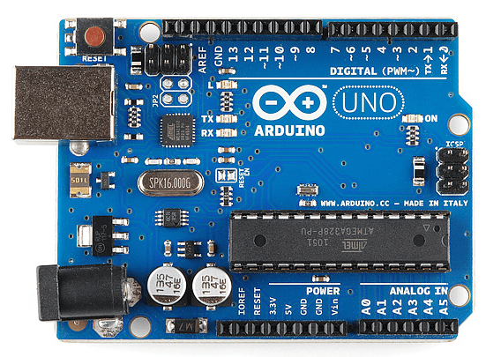
ARDUINO UNO
The Arduino Uno is an open-source microcontroller board based on the Microchip ATmega328P microcontroller.
It contains all the required tools to program the microcontroller and add different modules to it.

Slide 7
WHY ARDUINO?
Arduino uses the Arduino integrated development environment (IDE), which is a cross-platform application used specifically to program Arduino boards.
The Arduino IDE supports the languages C and C++ using special rules of code structuring.
Arduino is an open-source hardware and hence it is cheap, making the project cost a lot cheaper.

Slide 8
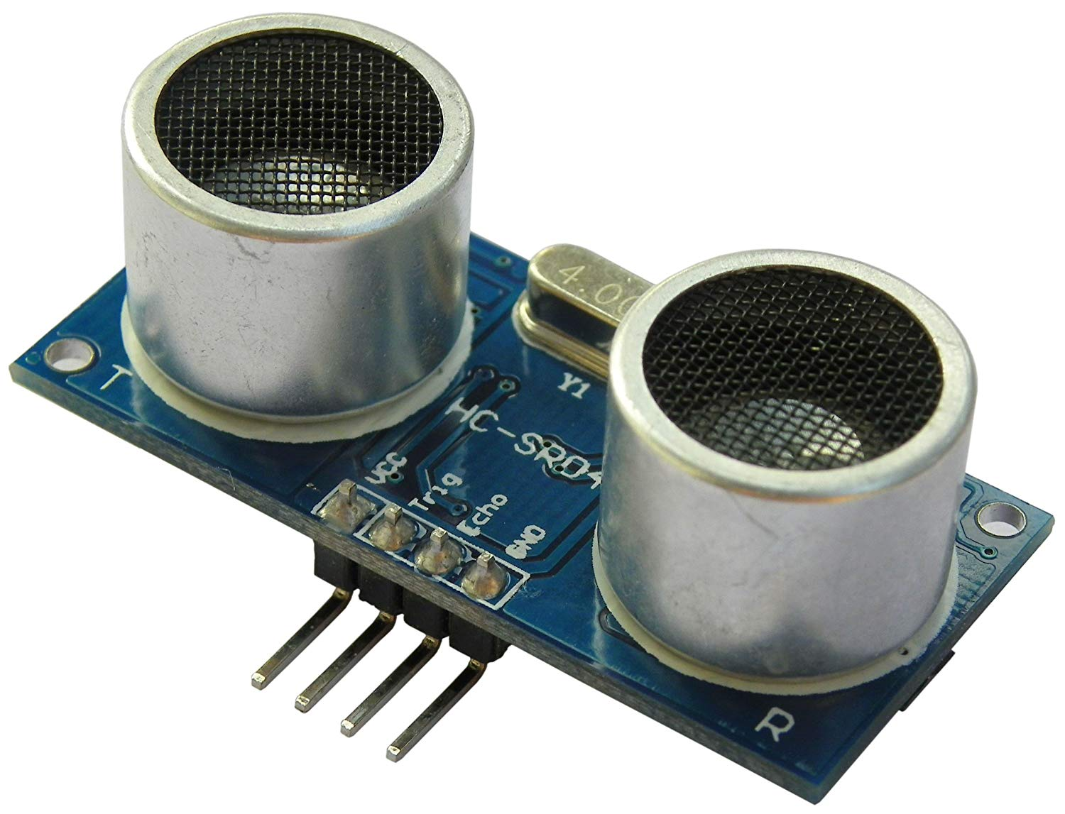
ULTRASONIC SENSOR
An ultrasonic sensor uses a single ultrasonic element for both emission and reception.
In a reflective model ultrasonic sensor, a single oscillator emits and receives ultrasonic waves alternately.
This enables miniaturization of the sensor head.

Slide 9
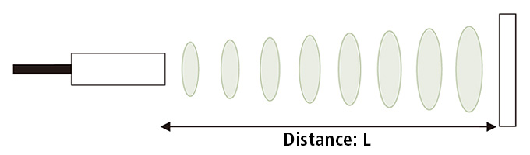
PRINCIPLE
As the name indicates, ultrasonic sensors measure distance by using ultrasonic waves.
The sensor head emits an ultrasonic wave and receives the wave reflected back from the target.
Ultrasonic Sensors measure the distance to the target by measuring the time between the emission and reception.

Slide 10
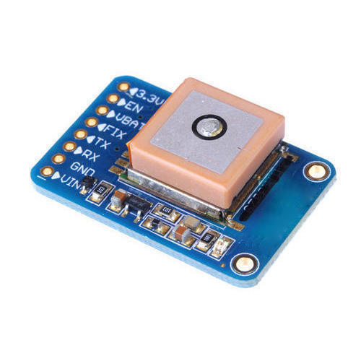
GPS MODULE
GPS stands for Global Positioning System by which anyone can always obtain the position information anywhere in the world.
We use GPS module in our project to obtain the location of crack detected.

Slide 11
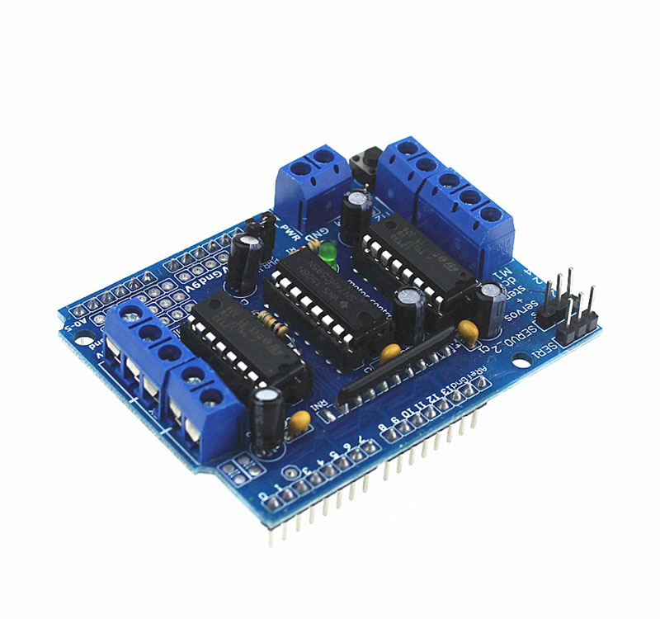
L293D MOTOR DRIVER
A motor driver is an integrated circuit chip which is usually used to control motors in autonomous robots.
Motor driver act as an interface between Arduino and the motors .

Slide 12
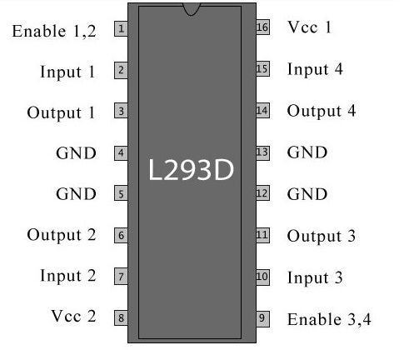
SCHEMATIC
The L293D is a 16 pin IC, with 8 pins, on each side, dedicated to the controlling of a motor.
There are 2 INPUT pins, 2 OUTPUT pins and 1 ENABLE pin for each motor.
L293D consist of two H-bridge. H-bridge is the simplest circuit for controlling a low current rated motor..

Slide 13

THANK YOU!
Notes:
Photo by Ousa Chea on Unsplash

